Slide 1
Portage Bear Attack (While Duck Hunting)
by Tim Baker

Slide 2
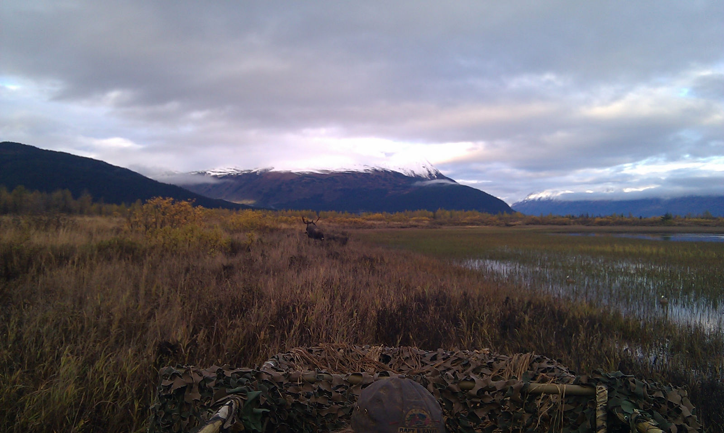
Notes:
This is the small bull moose the brown bear was following.

Slide 3
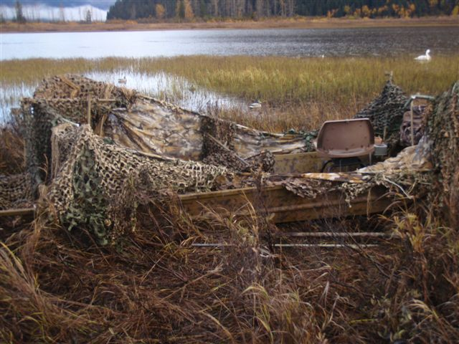
Notes:
This is what is left of the boat blind.

Slide 4
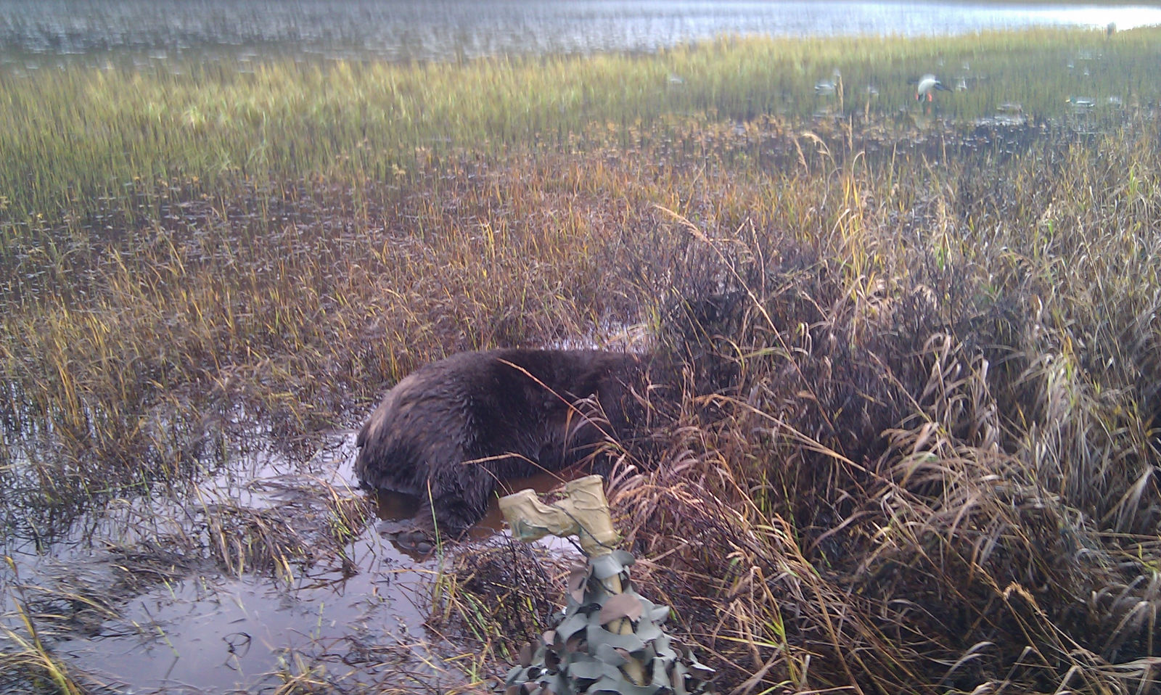
Notes:
Dead brown bear about 10 feet away from boat blind.

Slide 5
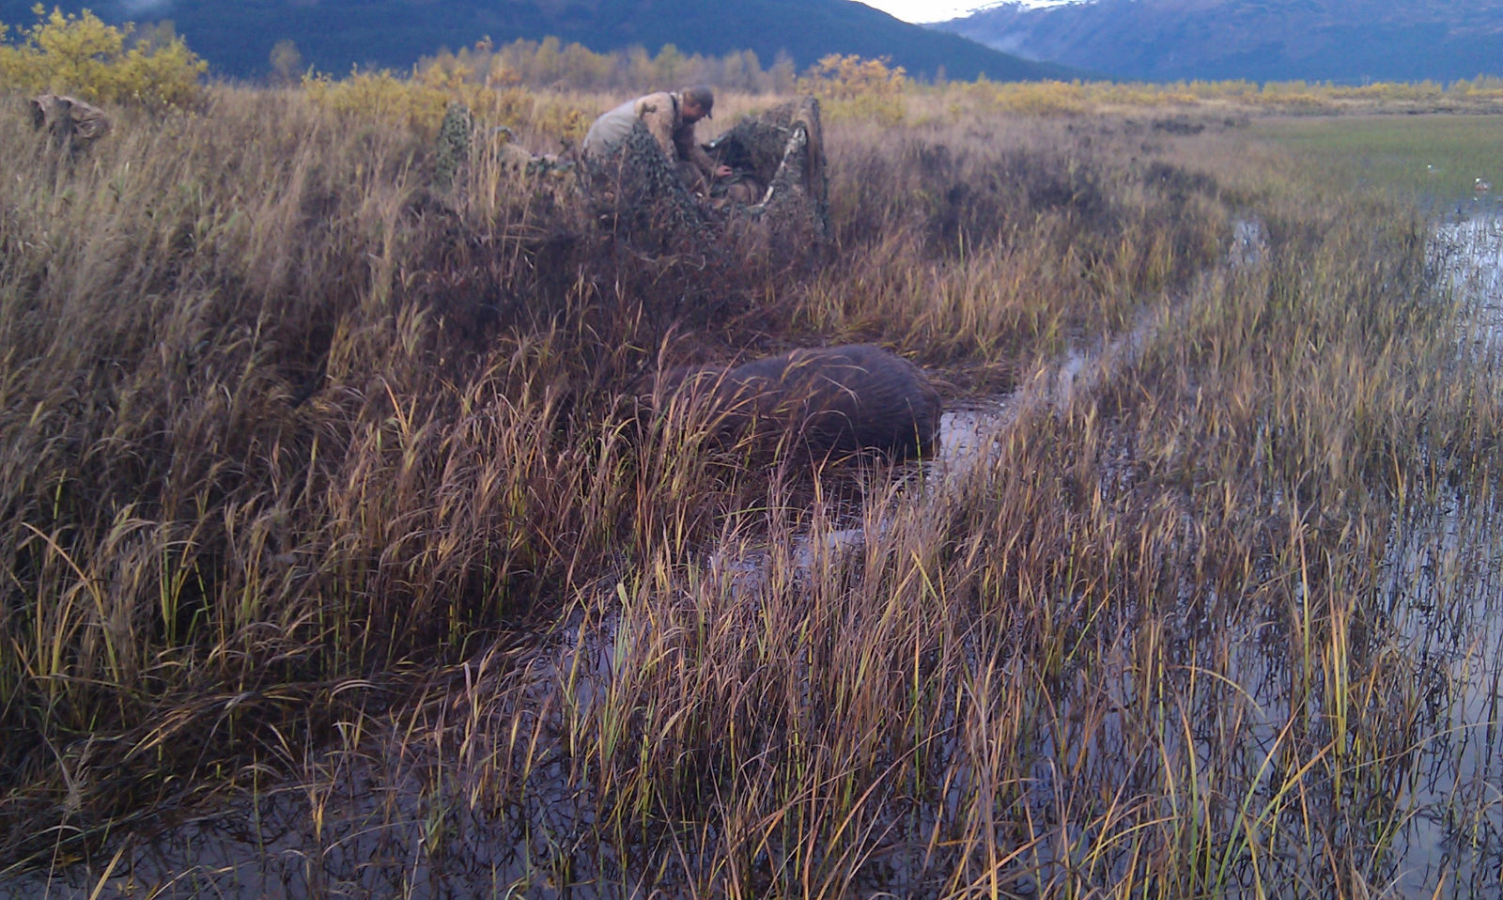

Slide 6
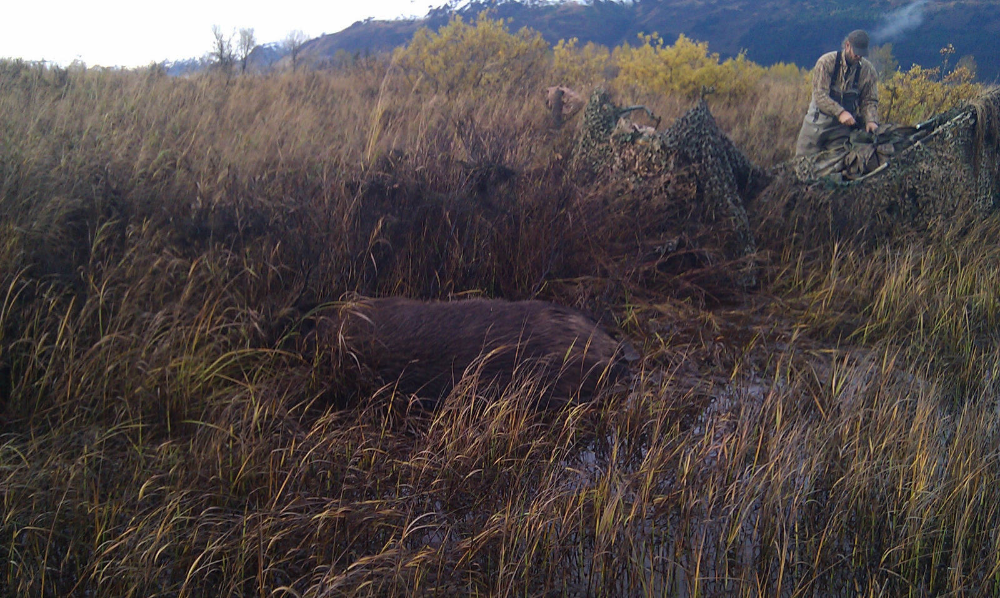

Slide 7
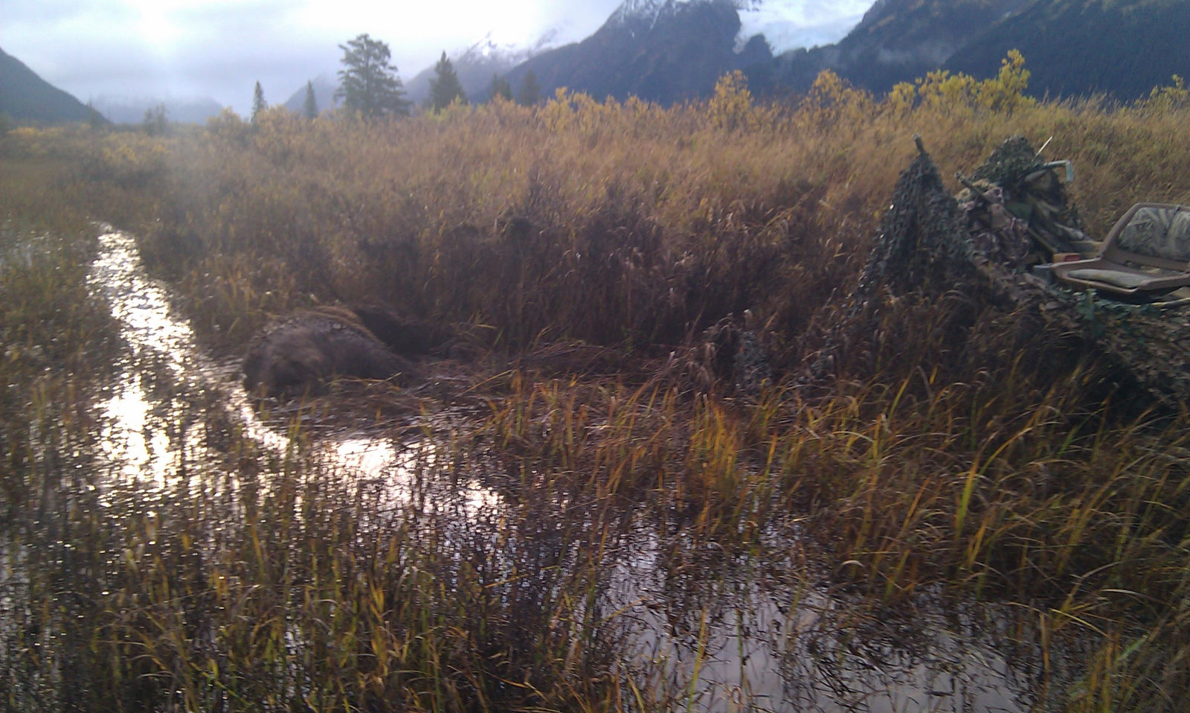

Slide 8
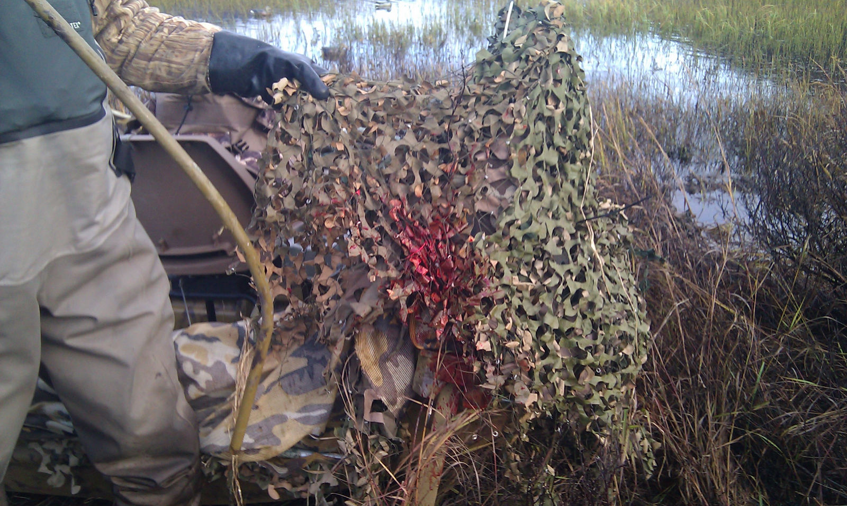
Notes:
Blood from brown bear on boat blind.

Slide 9
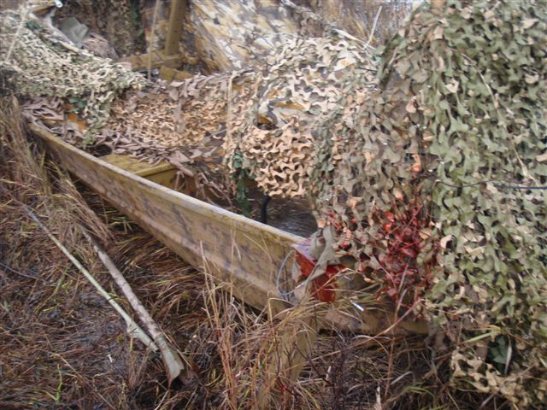
Notes:
Blood from brown bear on boat blind.

Slide 10
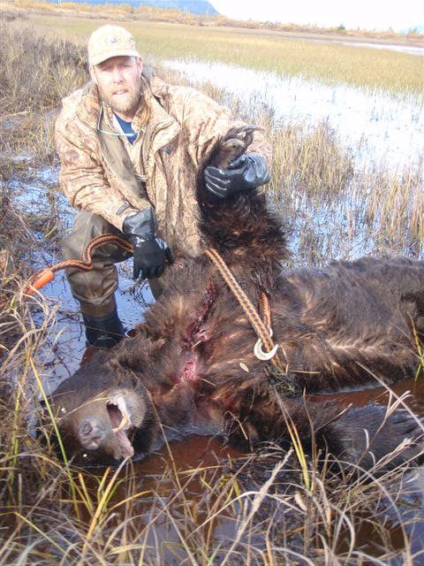

Slide 11
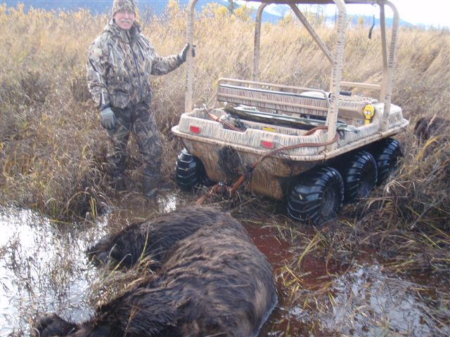

Slide 12
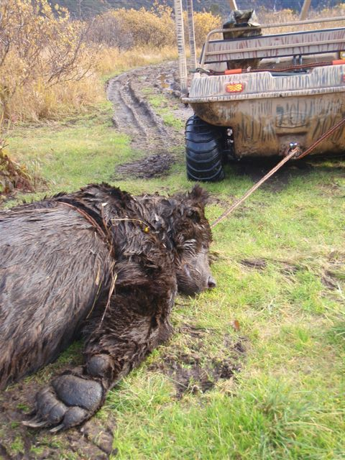

Slide 13
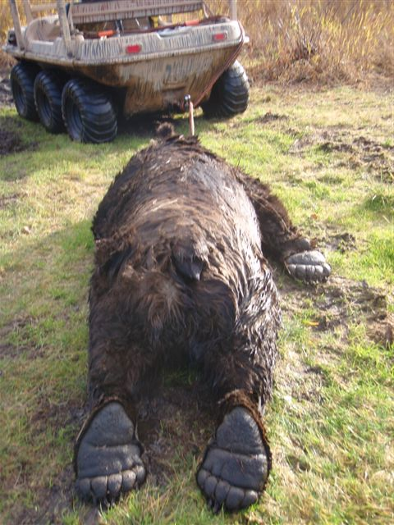

Slide 14
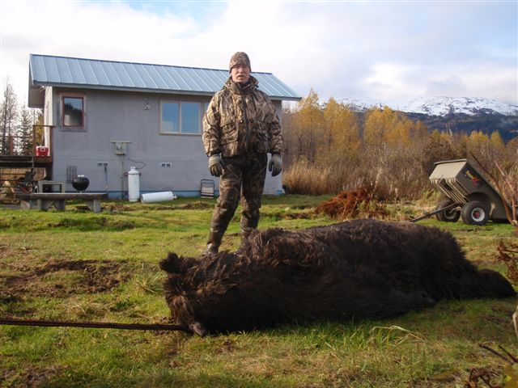

Slide 15
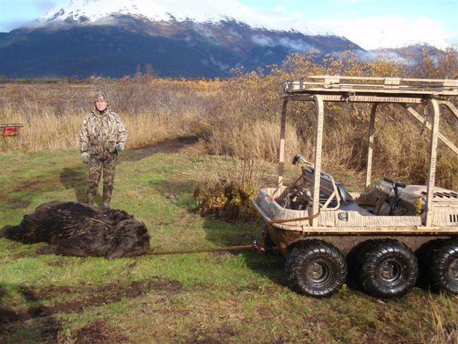

Slide 16
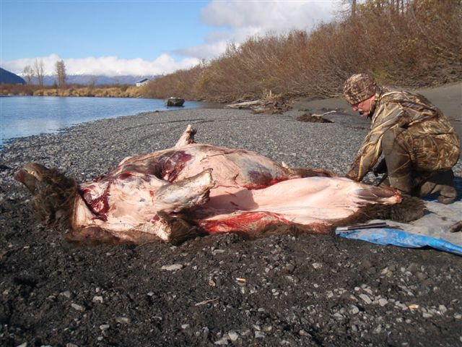

Slide 17
